Slide 1




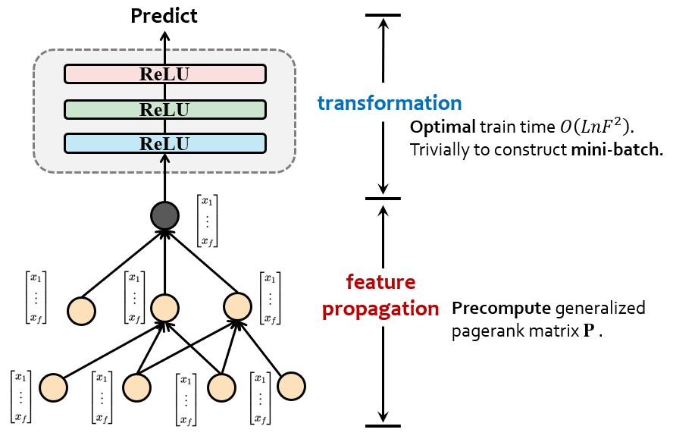
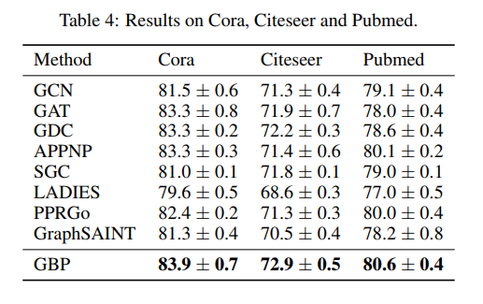
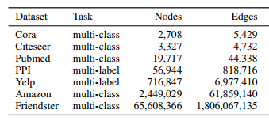
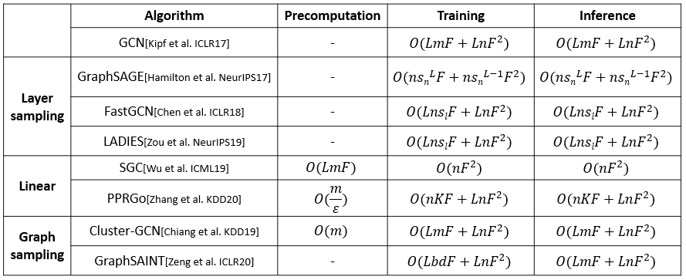
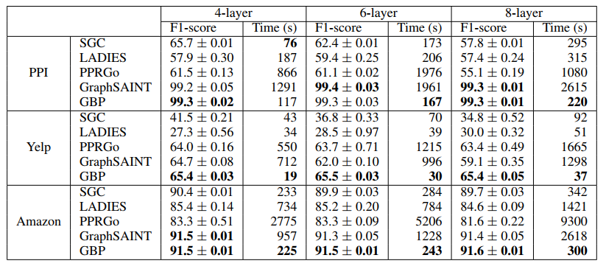
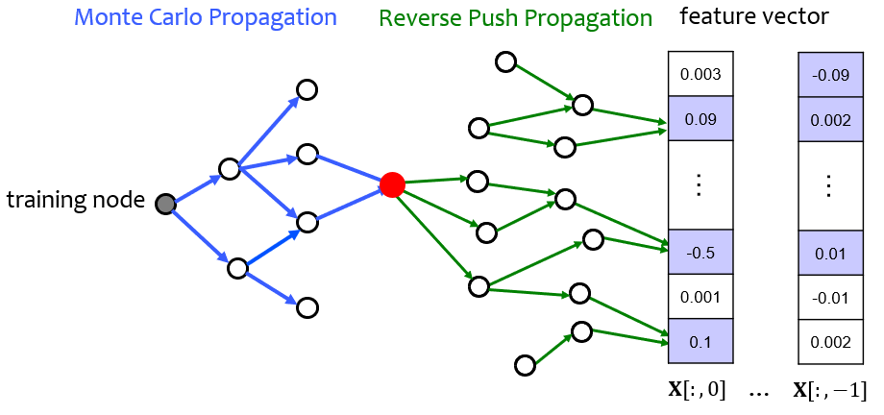
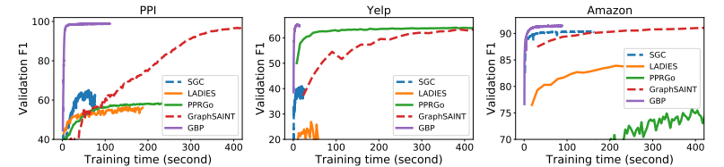
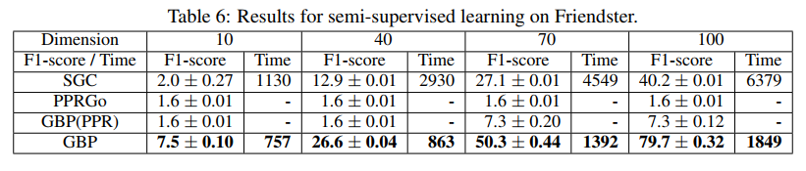
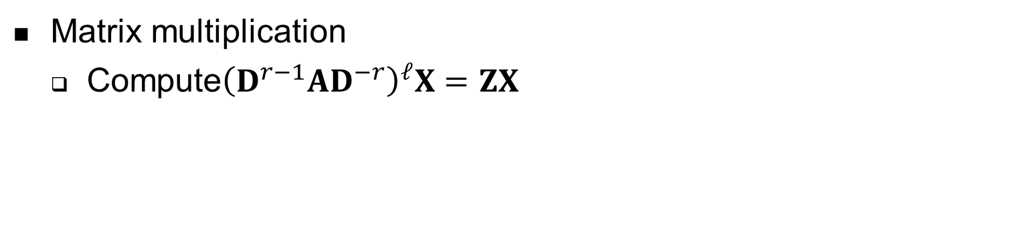

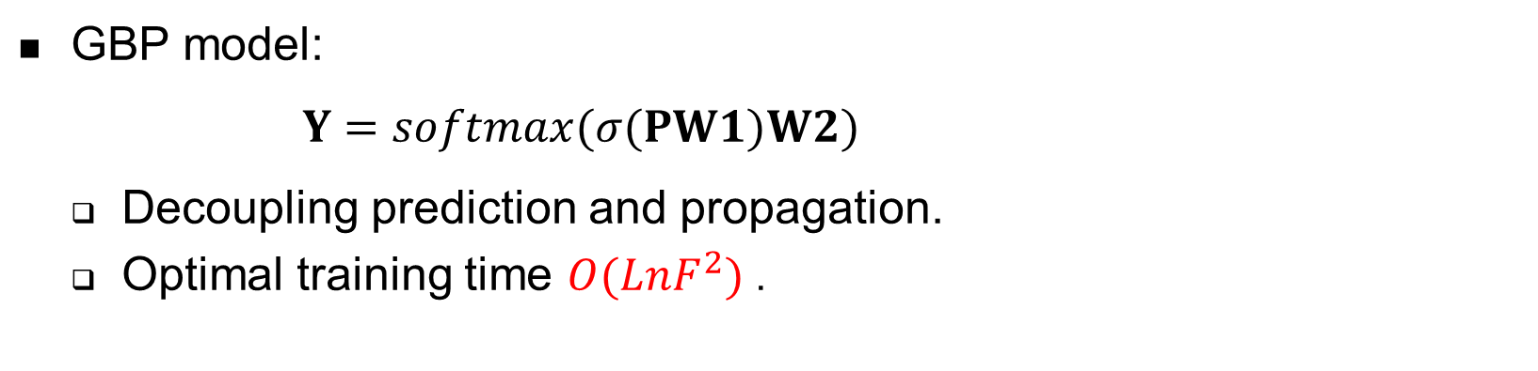
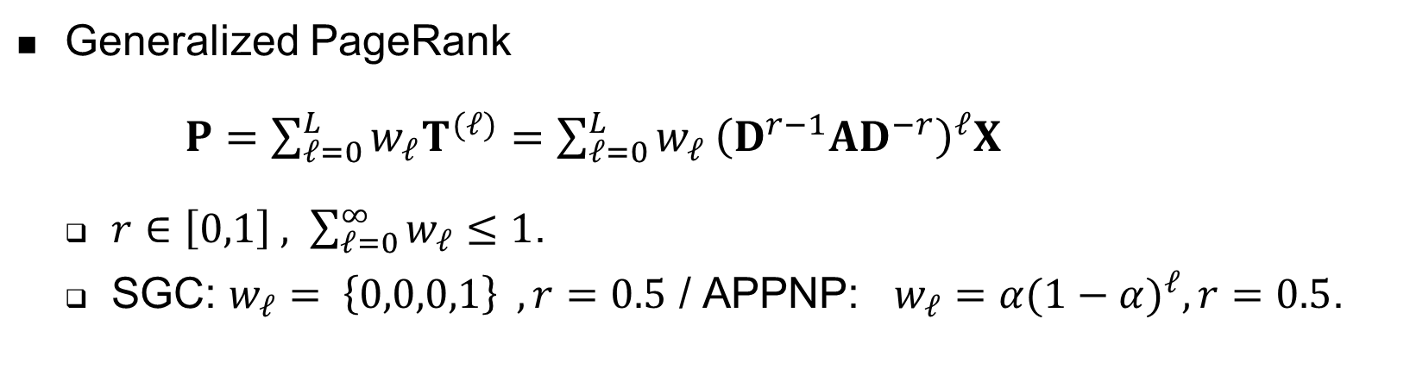
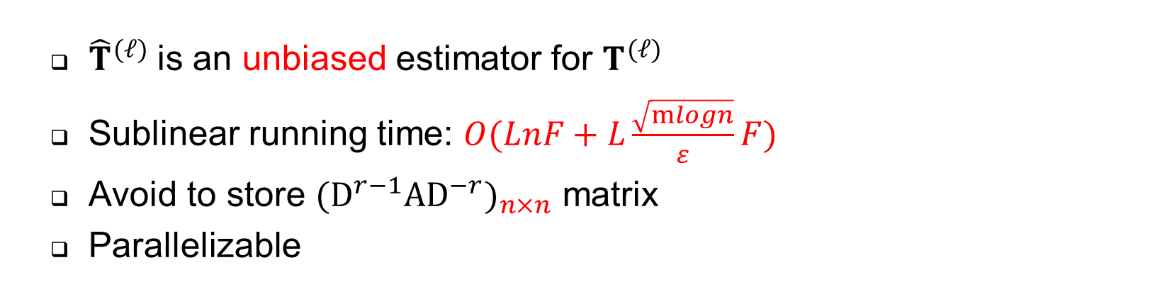
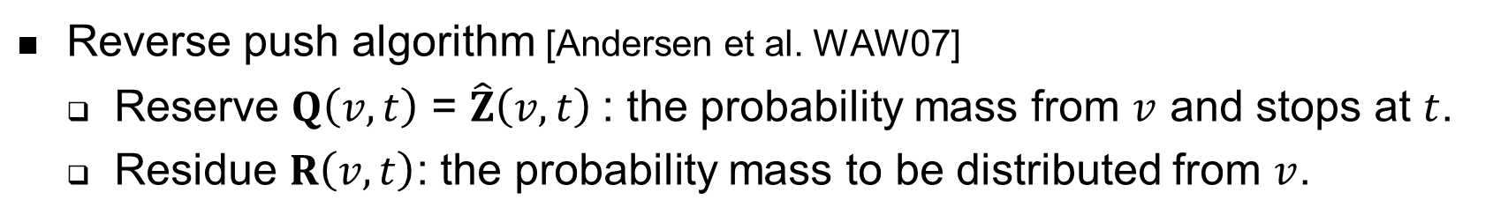
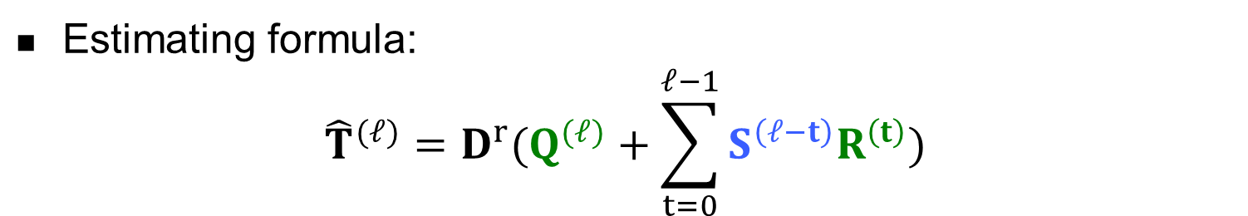
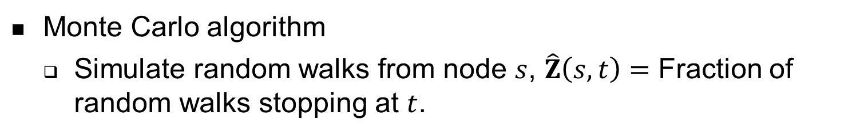
Scalable Graph Neural Networks via Bidirectional Propagation
Ming Chen, Zhewei Wei, Bolin Ding, Yaliang Li, Ye Yuan, Xiaoyong Du, Ji-Rong Wen
Contact: zhewei@ruc.edu.cn
Experiments
Problems
Baselines and datasets
  GCN、GAT、GDC、APPNP
  Linear: SGC、PPRGo
  Layer sampling: LADIES
  Graph sampling: GraphSAINT
Transductive learning on small graphs
Graph Neural Networks
  Full-batch training needs to store all node’s embedding in the GPU memory.
  Mini-batch training suffers from neighbor explosion problem.
Existing methods
  the time complexity is linear to the number of edges $m$.
Inductive learning on medium to large graphs
  Achieve comparable performance
  5-10x less running time
GBP model:
$Y=softmax(σ(PW1)W2)$
  Decoupling prediction and propagation.
  Optimal training time $O(LnF^{2})$ .
Precomputation:
  Combining Monte Carlo propagation from training nodes and reverse push propagation from feature vectors
Preliminaries
Matrix multiplication
  Compute${\left(D^{r−1}AD^{−r}\right)}^{𝓁}X=ZX$
Monte Carlo algorithm
  Simulate random walks from node $s$, $\hat{Z}\left(s,t\right)=$ Fraction of random walks stopping at $t$.
  Totally running time and performance
Reverse push algorithm [Andersen et al. WAW07]
  Reserve $Q\left(v,t\right)$ = $\hat{Z}\left(v,t\right)$: the probability mass from $v$ and stops at $t$.
  Residue $R\left(v,t\right)$: the probability mass to be distributed from $v$.
Bidirectional Propagation Method
Estimating formula:
$${\hat{T}}^{(ℓ)}=D^{r}(Q^{(ℓ)}+\sum_{t=0}^{ℓ−1}{S^{\left(ℓ−t\right)}R^{\left(t\right)}})$$
  Convergence curves
Transductive semi-supervised learning on billion-scale graph
  Deliver superior performance with half an hour on a single machine
Generalized PageRank
$P=\sum_{𝓁=0}^{L}{w_{𝓁}T^{(𝓁)}=\sum_{𝓁=0}^{L}{w_{𝓁}}{\left(D^{r−1}AD^{−r}\right)}^{𝓁}X}$
  $r∈\left[0,1\right] , \sum_{𝓁=0}^{∞}{w_{𝓁}}≤1$.
  SGC: $w_{𝓁}= \left\{0,0,0,1\right\} , r=0.5$ / APPNP: $w_{𝓁}=α{(1−α)}^{ℓ},r=0.5$.
  ${\hat{T}}^{(ℓ)}$is an unbiased estimator for $T^{(𝓁)}$
  Sublinear running time: $O(LnF+L\frac{\sqrt{mlogn}}{ε}F)$
  Avoid to store ${{(D}^{r−1}AD^{−r})}_{n×n}$ matrix
  Parallelizable

