Slide 1
PRSim: Sublinear Time SimRank Computation on Large Power-Law Graphs.
Zhewei Wei, Xiaodong He, Xiaokui Xiao, Sibo Wang, Yu Liu, Xiaoyong Du, and Ji-Rong Wen.
Zhewei Wei
Renmin University of China

Slide 2
Problems and Motivations

Slide 3



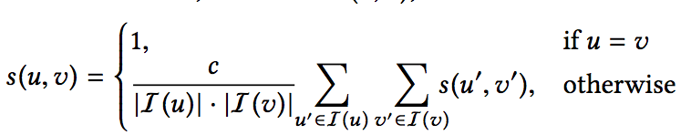

SimRank [KDD 02]
Professor A
Student A
University
Similarity=1
High
High
Professor B
Student B
$$c∈(0,1)$$

Slide 4
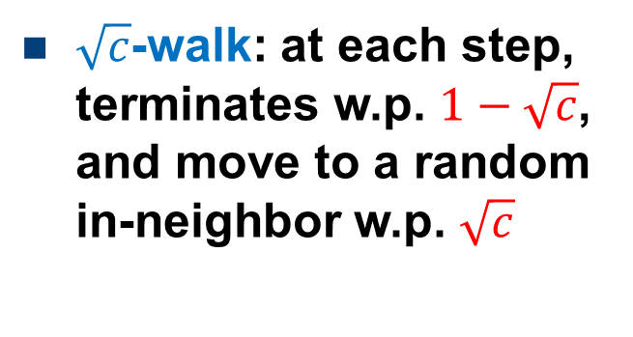
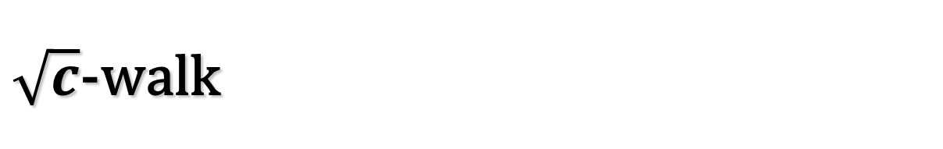
$\sqrt{c}$-walk
10
9
2
12
1
8
3
11
4
6
5
$\sqrt{c}$-walk: at each step, terminates w.p. $1−\sqrt{c}$, and move to a random in-neighbor w.p. $\sqrt{c}$
7

Slide 5


SimRank and $\sqrt{c}$-walk
10
9
2
12
1
8
3
11
4
6
5
s(u,v)=Pr{two $\sqrt{c}$-walks from u, v meet at the same step}
7

Slide 6
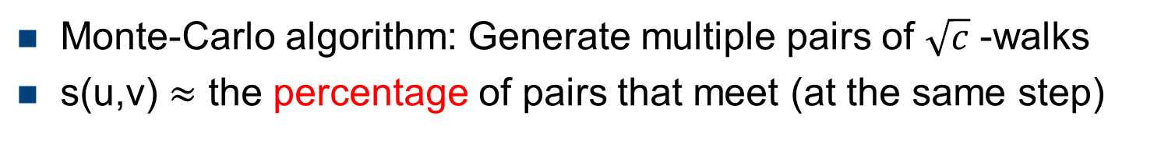

SimRank and $\sqrt{c}$-walk
10
9
2
12
1
8
3
11
4
6
5
s(u,v)=Pr{two $\sqrt{c}$-walks from u, v meet at the same step}
7
Monte-Carlo algorithm: Generate multiple pairs of $\sqrt{c}$ -walks
s(u,v) $≈$ the percentage of pairs that meet (at the same step)

Slide 7
Single-Source and top-k SimRank Queries
0.0
0.0
 | Node 4
Node 1 Node 2 Node 3 Node 4 Node 5 Node 6 Node 7 Node 8 Node 9 Node 10 Node 11 Node 12 | 0.43 0.10 0.13 0.46 0.05 0.05 0.0 0.0 0.0 0.0 0.0
10
0.10
9
12
0.43
2
0.0
0.0
1
8
0.13
11
3
0.0
4
0.05
6
5
0.46
7
0.05
Top-2 query for node 4：1, 5
Single-source query for node 4
Allow an error of predetermined ε

Slide 8
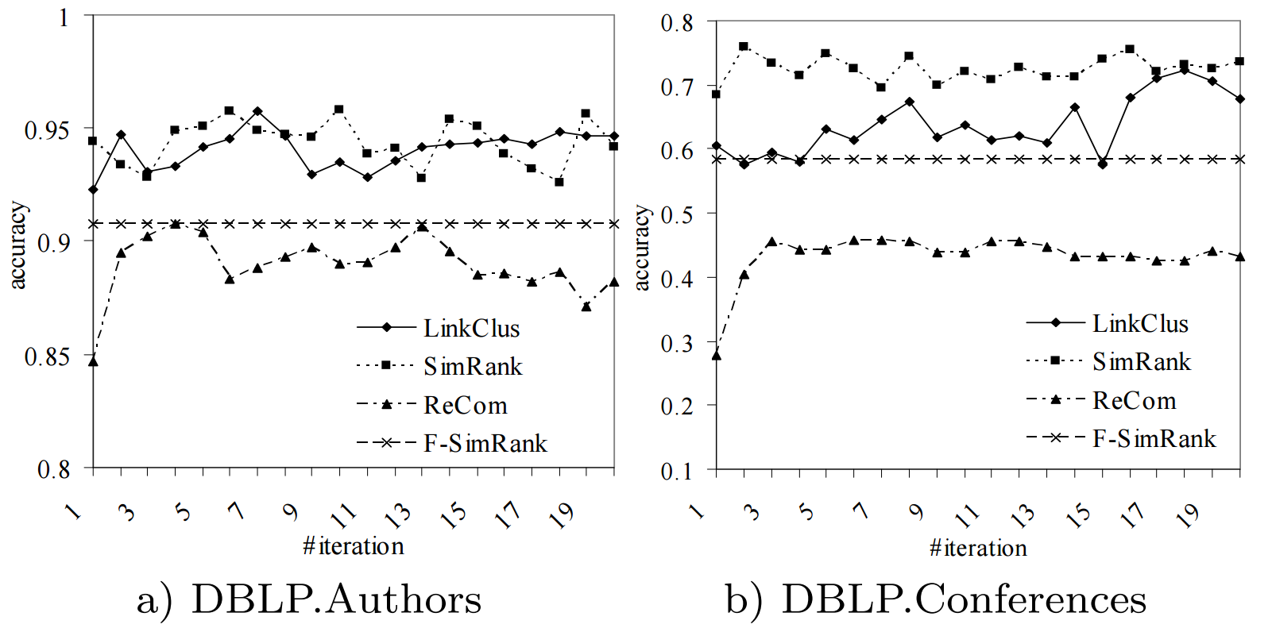
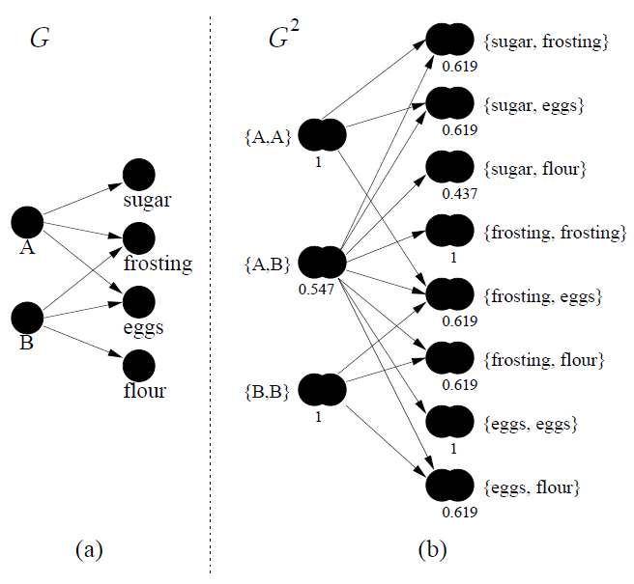
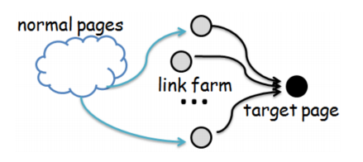
Applications
  SPAM detection [KDD12]
  Recommendation system [WWW15]
  Clustering via semantic links [VLDB06]
Notes:
(1min)There are lots of applications of SimRank, like collaborative filtering and recommendation systems.
For example, consider the system needs to guess the rating of a user to a given singer, to determine whether to recommend the singer to him.
First the system needs to find k most similar singers already rated by the user, by some similarity measure such as SimRank, which performs well.
Then the system computes a weighted score according to the similarity.

Slide 9
Taxonomy
Iterative
Non-iterative
Random Walk
PartialSum
Lizorkin, VLDB08
Monte Carlo
EDBT04, WWW05
NI-Sim
C. Li, EDBT10
FS-SR
P. Li, SDM10
TopSim
Jeffery Yu, ICDE12
Linearization
Kusumoto, SIGMOD14
KDD14, ICDE15
SRK-Join
G. Li, VLDB14
OIP
W Yu, ICDE13
Information
Sciences17
Par-SR
W Yu, VLDB15
CloudWalker
VLDB15
Bin Cui, VLDB15
READS
W Yu, VLDB17

Slide 10
Drawback 1: Linear Query Time
Existing methods (READS[VLDB18], TSF[VLDB15], MC..)
u
1
…
i
n
# nodes = 10,000,000

Slide 11
Drawback 2: SimRank v.s. Graph Structure
Dataset | Type | n | m
It-2004 | directed | 41,291,594 | 1,150,725,436
Twitter-2010 | directed | 41,652,230 | 1,468,365,182
Query Time (Sec)
Dataset | ProbeSim | TSF | TopSim-SM | Trun-TopSim | Prio-TopSim
it-2004 | 0.018 | 1.01 | 35.18 | 0.67 | 0.2
twitter-2010 | 13.6 | 191.28 | N/A | N/A | N/A

Slide 12
Our Results

Slide 13
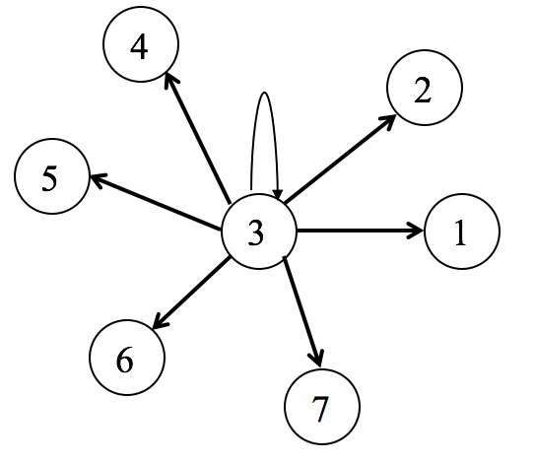
1. Achieving Sub-Linear Time
Can we do better than O(n) on worst case graphs？
SimRank
 | 1 | 2 | 3 | 4 | 5 | 6 | 7
1 | 1 | c | c | c | c | c | c
2 | c | 1 | c | c | c | c | c
3 | c | c | 1 | c | c | c | c
4 | c | c | c | 1 | c | c | c
5 | c | c | c | c | 1 | c | c
6 | c | c | c | c | c | 1 | c
7 | c | c | c | c | c | c | 1
Output size: O(n)

Slide 14
The end?

Slide 15
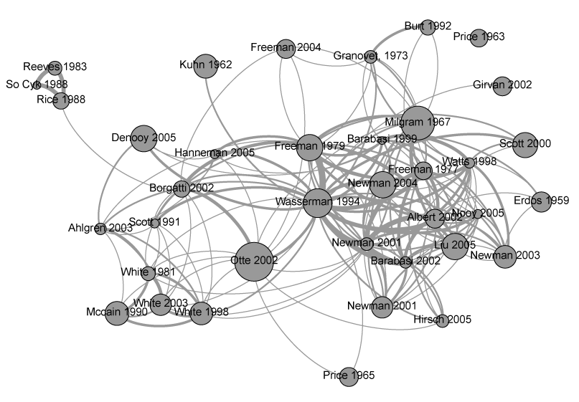
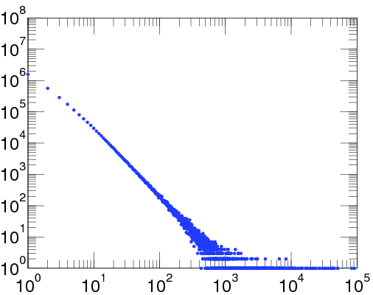
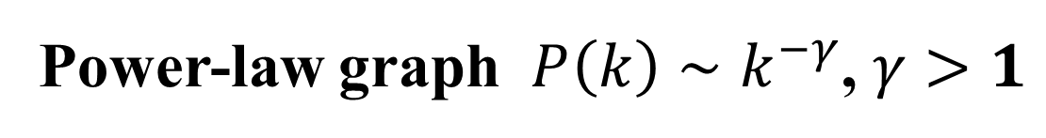
1. Achieving Sub-Linear Time
Can we do better than O(n) on Real-world graphs？
Power-law graph $P\left(k\right)∼k^{−γ}$, $γ>1$

Slide 16
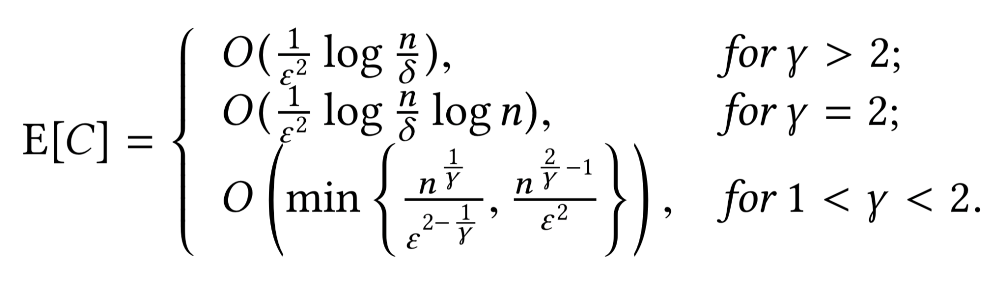
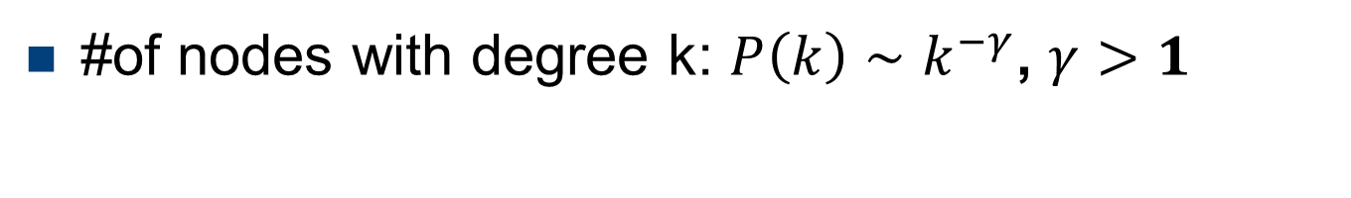
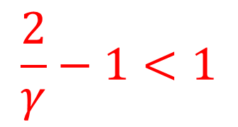
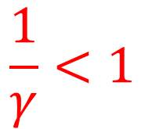
PRSim: Query time
#of nodes with degree k: $P\left(k\right)∼k^{−γ}$, $γ>1$
$$\frac{1}{γ}<1$$
$$\frac{2}{γ}−1<1$$

Slide 17
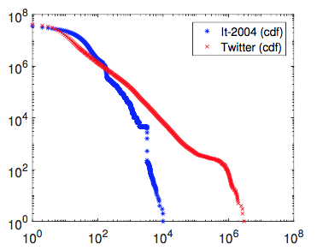
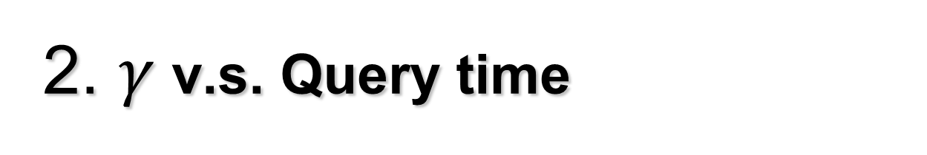


2. $γ$ v.s. Query time
Dataset | Type | n | m
It-2004 | directed | 41,291,594 | 1,150,725,436
Twitter-2010 | directed | 41,652,230 | 1,468,365,182
Small $γ$
Large $γ$
Query Time (Sec)
Dataset | ProbeSim | TSF | TopSim-SM | Trun-TopSim | Prio-TopSim
it-2004 | 0.018 | 1.01 | 35.18 | 0.67 | 0.2
twitter-2010 | 13.6 | 191.28 | N/A | N/A | N/A

Slide 18
High Level Ideas

Slide 19
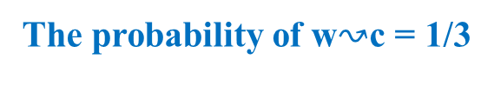
PRSim: High level ideas
Reversely calculate probability trees
  Precomputation
  Sample in the query phase
d
c
The probability of w$↝$c = 1/3
i
b
a
j
k
f
u
x
s
z
t
w
depth = 2
depth = 3
depth = 4

Slide 20
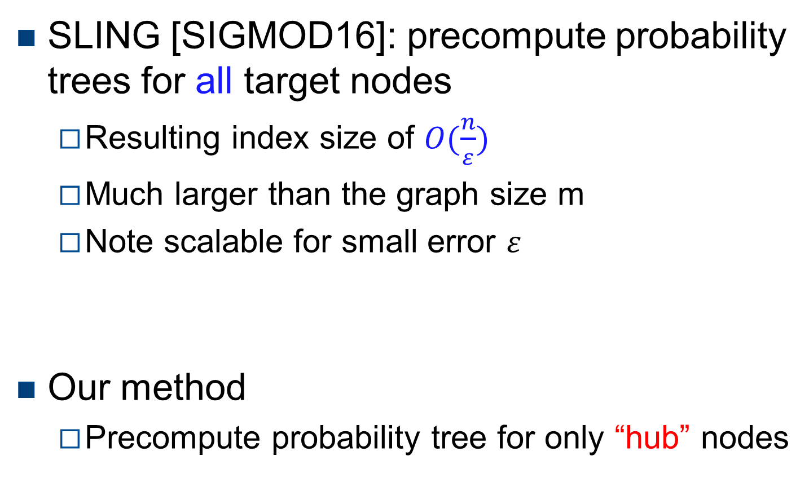
Indexing Probability Trees
SLING [SIGMOD16]: precompute probability trees for all target nodes
  Resulting index size of $O(\frac{n}{ε})$
  Much larger than the graph size m
  Note scalable for small error $ε$
Our method
  Precompute probability tree for only “hub” nodes

Slide 21
Indexing
Hub nodes: nodes with high PageRanks
A random walk from a random source node u is more likely to visit nodes with higher PageRanks
Precomputing probability trees for hub nodes is the most efficient way to reduce query time

Slide 22

Probe Algorithm [VLDB18]
Estimate the probability tree for non-hub nodes in the query phase
Sample w according to Pr[w$↝$c] = 1/3
d
c
Sample node i w.p. 1
Sample nodes j, k w.p. 1
Sample node f w.p. 1/3
i
b
a
j
k
f
u
x
s
z
t
w
depth = 2
depth = 3
depth = 4

Slide 23
Backward Walk Algorithm
Probe algorithm: not efficient for nodes with large out-degrees
w
…
j
k
l
p
q
t

Slide 24
Backward Walk Algorithm
Probe algorithm: not efficient for nodes with large out-degrees
Backward Walk algorithm
  Sort adjacency list by in-degrees in preprocess
w
r = 0.3
…
j
k
l
p
q
t
Throw a random number r
Only visit nodes with indegree <1/r

Slide 25
Experiments

Slide 26
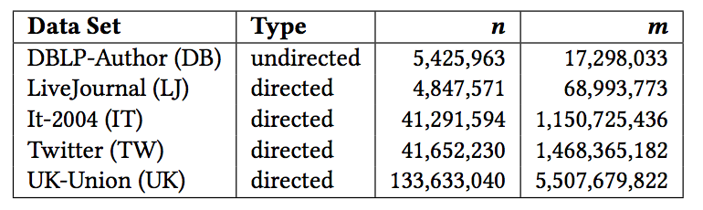
Experiments
Datasets:
Competitors:
  Index-based: READS[VLDB18], SLING[SIGMOD16] and TSF[VLDB15]
  Index-free: ProbeSim[VDLB18] and TopSim[ICDE12]
Pooling [VLDB18] to evaluate precision on large graphs without ground truth

Slide 27
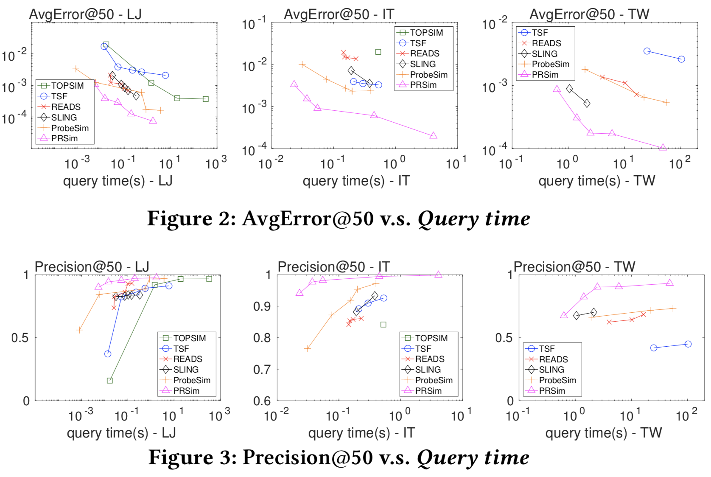
Experiments

Slide 28
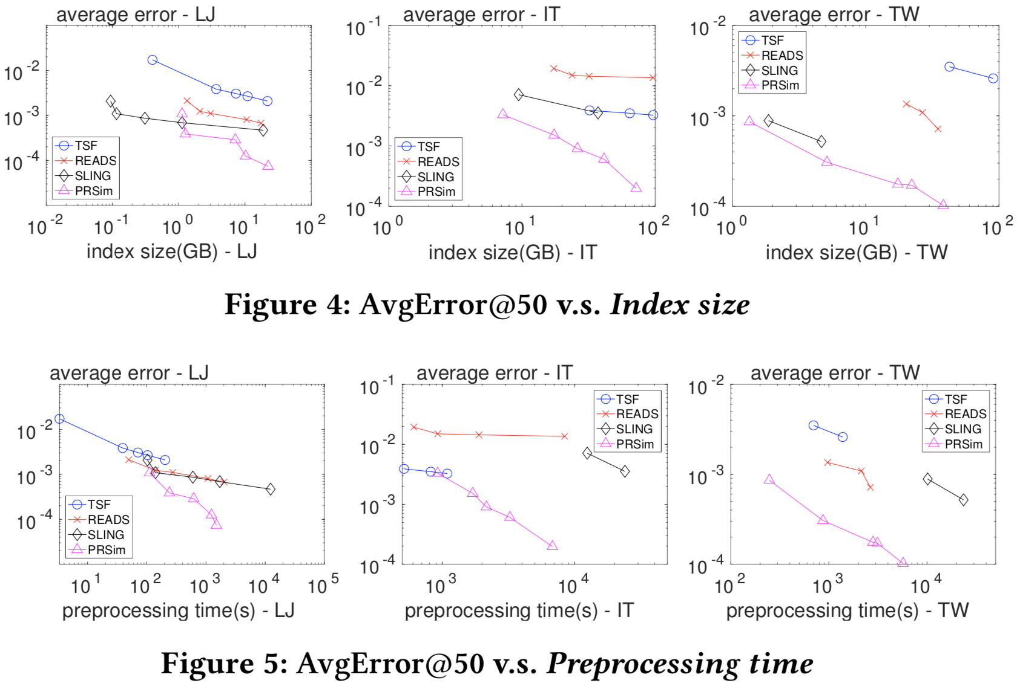
Experiments

Slide 29
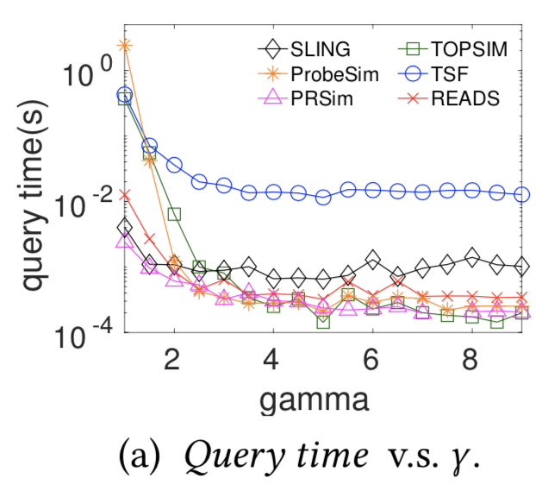
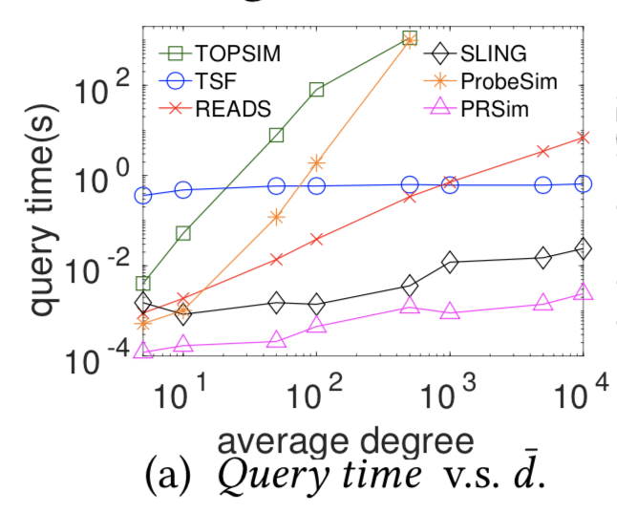
Experiments
Synthetic Power-Law graphs
Synthetic ER graphs

Slide 30
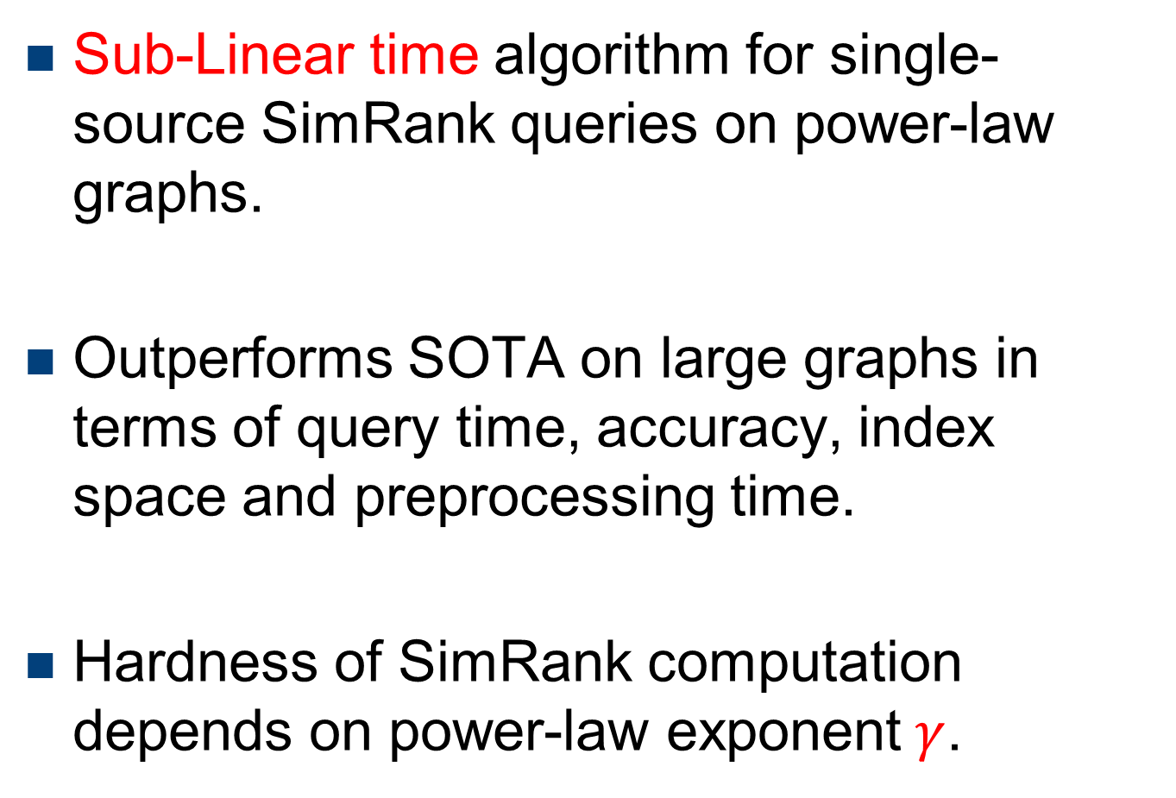
Conclusion
Sub-Linear time algorithm for single-source SimRank queries on power-law graphs.
Outperforms SOTA on large graphs in terms of query time, accuracy, index space and preprocessing time.
Hardness of SimRank computation depends on power-law exponent$γ$.

Slide 31
Thank you!

