Slide 1




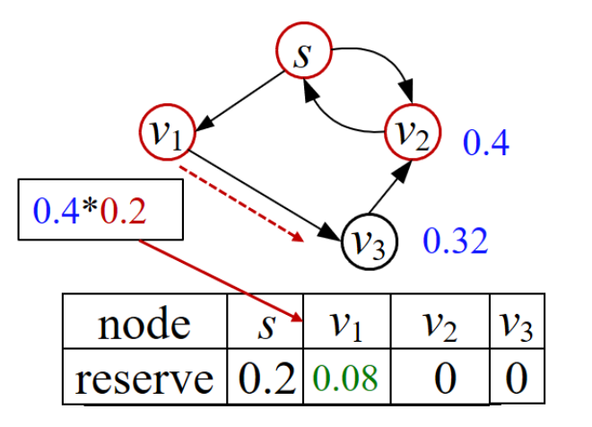
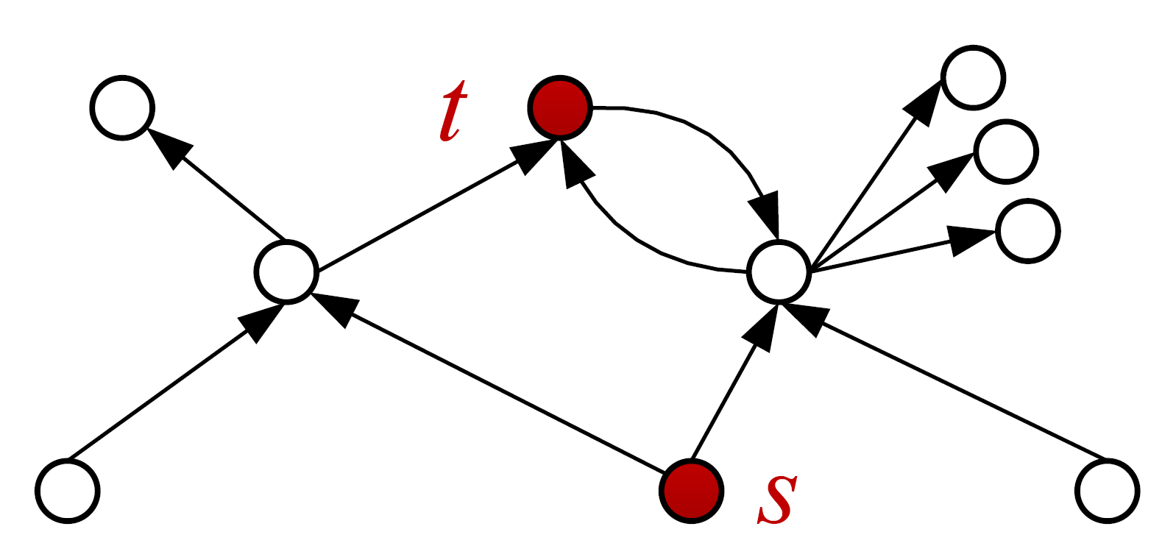

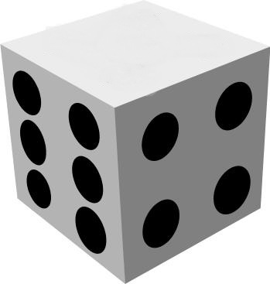
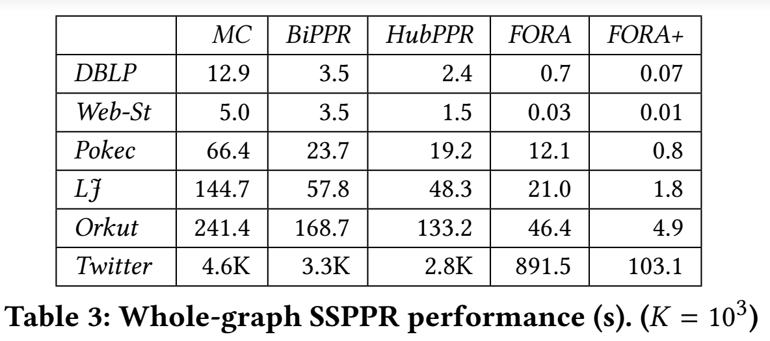
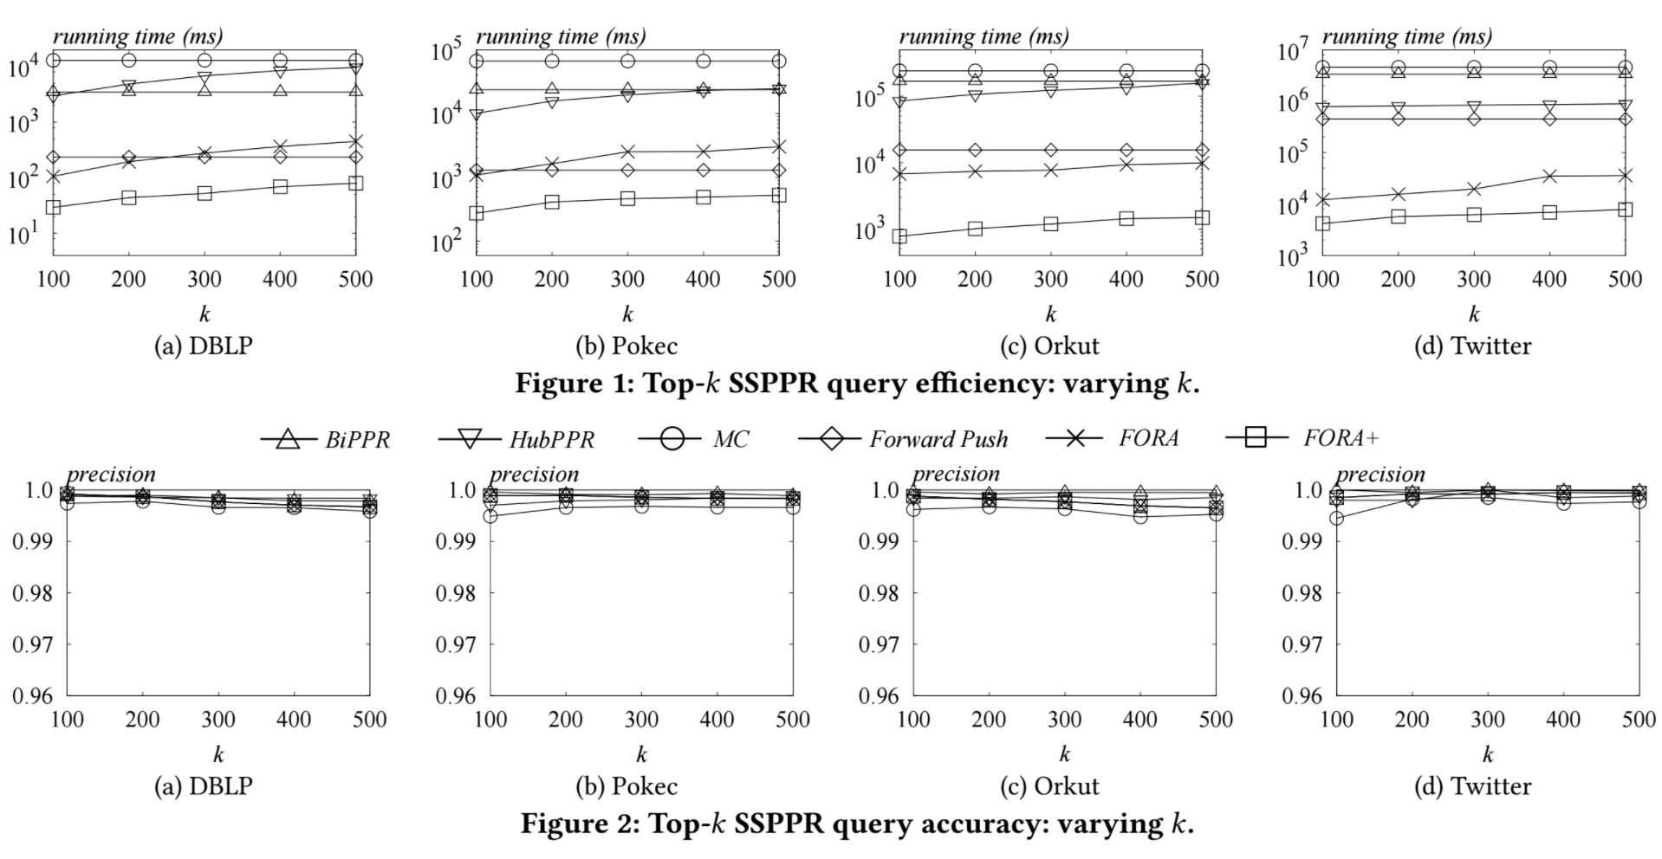
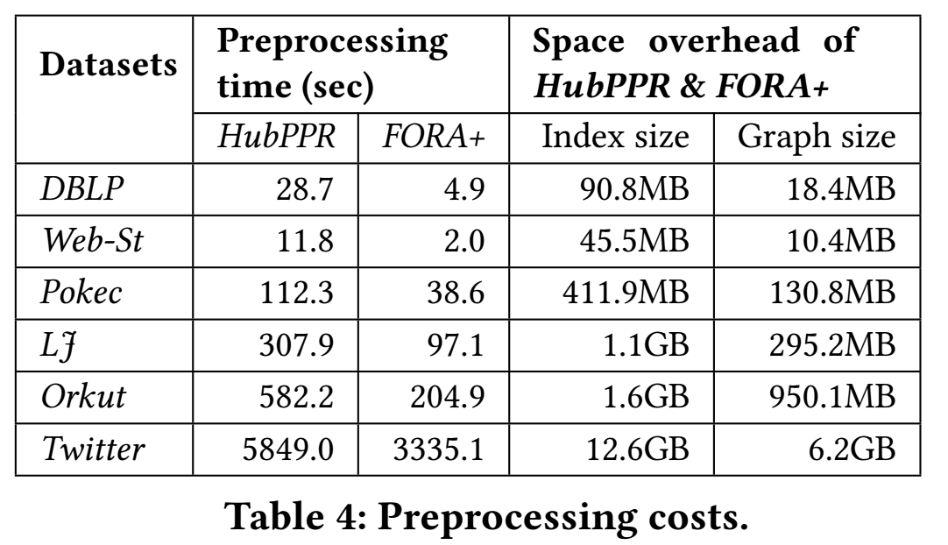


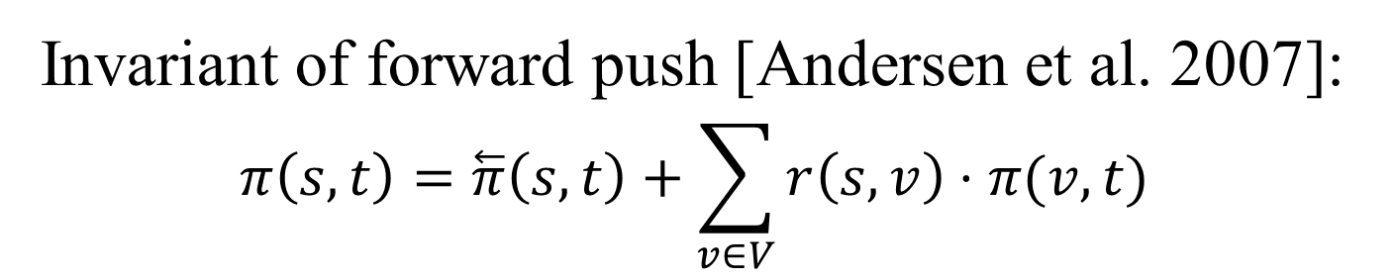
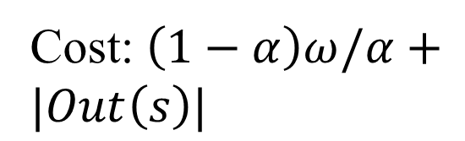
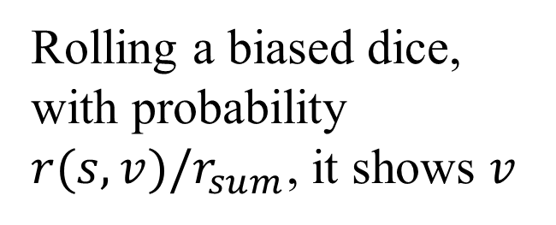




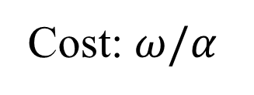
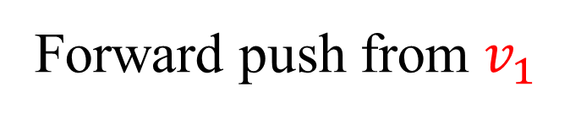
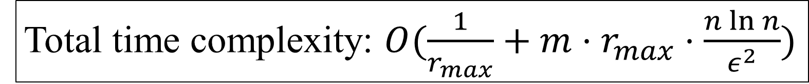


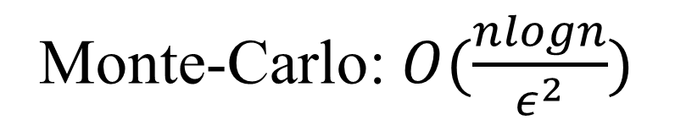


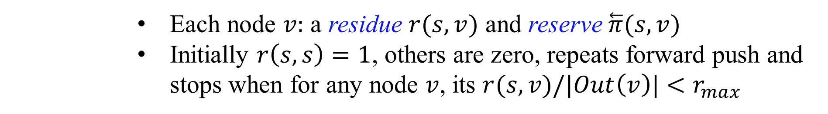
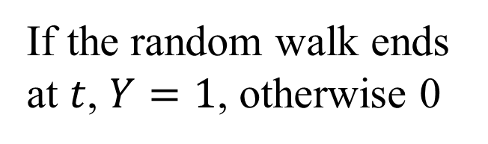




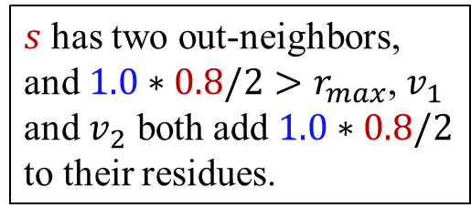
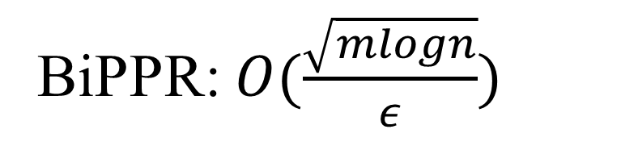






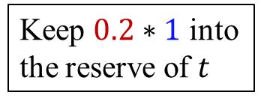


FORA: Simple and Effective Approximate
Single­-Source Personalized PageRank
Sibo Wang, Renchi Yang, Xiaokui Xiao, Zhewei Wei, Yin Yang
School of Information Technology
and Electrical Engineering
1. Personalized PageRank
2. Solution Overview
The Personalized PageRank (PPR) from 𝑠 to 𝑡 is
  𝜋(𝑠,𝑡)=ℙ[Random walk from 𝑠 stops at 𝑡]
  Random walk: With probability $α$ terminates, otherwise randomly jumps to one of the out-neighbour
  Two queries
    Approximate whole graph single-source PPR query: $(δ, ε,p_{fail})$
    Approximate Top-𝑘 single-source PPR: return the top-k nodes with the largest PPR value with respect to 𝑠: $(δ, ε,p_{fail})$
Approximate top-$k$ single-source PPR (SSPPR)
  𝛿=0.01, 𝜖=0.1, $T=\left\{v_{1},v_{2},v_{3},v_{4}\right\},π(s,v_{1} )=0.3, π(s,v_{2} )=0. 2,π(s,v_{3} )=0.18, π(s,v_{4} )=0.17$
    Top-3: $\tilde{π}\left(s,v_{1}\right)=0.3,\tilde{π}\left(s,v_{2}\right)=0.2, \tilde{π}\left(s,v_{4}\right)=0.18$
Existing solutions
  Problems of existing solutions: Monte-Carlo approach: still too expensive; BiPPR: needs backward phase from each target node
Basic idea of FORA: FOrward push + RAndom Walk
Intuition
  If we sample $ω$ random walks from s, how many will reach $v_{1}$?
Forward Push
  Time complexity:
    $O(1/r_{max}⁡)$
Random Walk
  Let $ω$ be the number of random walks required by Monte-Carlo
    From each node, sample $ω⋅r(s,v)$ random walks
$$ω$$
$$v_{1}$$
$$(1−α)ω/3$$
Sample $ω$ random walks from $s$
Cost: $ω/α$
$$s$$
$$v_{3}$$
$$v_{2}$$
$$(1−α)ω/3$$
Sample $\left(1−α\right)ω/3$ random walks from each of $s$’s out-neighbour
Cost: $\left(1−α\right)ω/α+|Out\left(s\right)|$
$$(1−α)ω/3$$
  Each node $v:$ a residue $r(s,v)$ and reserve $\overset{⃖}{π}(s,v)$
  Initially $r\left(s,s\right)=1$, others are zero, repeats forward push and stops when for any node $v$, its $r(s,v)/|Out\left(v\right)|<r_{max}$
Keep $0.2∗1$ into
the reserve of $t$
$s$ has two out-neighbors, and $1.0∗0.8/2>r_{max}$, $v_{1}$ and $v_{2}$ both add $1.0∗0.8/2$ to their residues.
0.4
v
1
1
s
v
2
0.4
$$\tilde{|π}\left(s,v_{4}\right)−π\left(s,v_{4}\right)|≤0.1∗π\left(s,v_{4}\right),$$
$$|π\left(s,v_{4}\right)−π\left(s,v_{3}\right)|≤0.1∗π\left(s,v_{3}\right)$$
v
3
$$v_{1}$$
node
s
v
1
v
2
v
3
$$v_{1}$$
reserve
0
0
0
0
$$v_{1}$$
0.2
s
$$v_{2}$$
...
$$v_{2}$$
t
Forward push from s
Forward push from $v_{1}$
$$v_{1}$$
Invariant of forward push [Andersen et al. 2007]:
$$π\left(s,t\right)=\overset{⃖}{π}\left(s,t\right)+\sum_{v∈V}{r\left(s,v\right)⋅π(v,t)}$$
Monte-Carlo: $O(\frac{nlogn}{ε^{2}})$
BiPPR: $O(\frac{\sqrt{mlogn}}{ε})$
3. FORA: Analysis & Extensions
4. FORA: Top-$k$ Processing
Analysis
$π\left(s,t\right)=\overset{⃖}{π}\left(s,t\right)+\sum_{v∈V}{r\left(s,v\right)⋅π(v,t)}$
$X=\sum_{v∈V}{r\left(s,v\right)⋅π\left(v,t\right), r_{sum}=}\sum_{v∈V}{r(s,v)}$
Random variable $Y$
    $r_{sum}⋅E\left[Y\right]=X$
    Random walk needed: $O\left(r_{sum}⋅\frac{n\ln{n}}{ε^{2}}\right)=O(m⋅r_{max}⋅\frac{n\ln{n}}{ε^{2}})$
  Optimal: $O(\frac{1}{ε}\sqrt{m⋅n⋅\ln{n}})$ on general graph, $O\left(\frac{1}{ε}n⋅\ln{n}\right)$ on scale graphs
Extensions
Indexing: pre-store random walks
  For node $v$: $\left|Out\left(v\right)\right|⋅r_{max}⋅ω$
  Total space complexity: identical to time complexity
Source as a distribution
  Initialize residues according to the distribution
Setting $δ=1/n$ is too conservative, we only need to provide approximation for the $k−$th largest PPR
Challenge:
  The 𝑘-th largest PPR value is unknown
  But we need to guarantee approximation for the 𝑘-th largest PPR value to terminate
A test-and-trial early termination mechanism
Stopping mechanism
  $UB\left(v_{i}\right)<\left(1+ε\right)⋅LB\left(v_{i}\right)$
  $LB\left(v_{k}\right)≥δ$
  Any node $u$ in $V∖\{v_{1},⋯,v_{k}\}$ whose $UB\left(u\right)>\left(1+ε\right)⋅LB(v_{k})$ satisfy that $UB\left(u\right)>(1+ε)/\left(1−ε\right)LB(u)$
Bound refinement
  In each iteration, we can derive the upper and lower bound using concentration inequalities
  The inequality requires to know the upper and lower bound of the PPR value
Rolling a biased dice, with probability $r(s,v)/r_{sum}$, it shows $v$
v
$$v$$
If the random walk ends at $t$, $Y=1$, otherwise 0
$$δ=1/k$$
𝛿=1/𝑘
Run FORA
Stopping condition test
Return the top-k answer
passed
Total time complexity: $O(\frac{1}{r_{max}}+m⋅r_{max}⋅\frac{n\ln{n}}{ε^{2}})$
Failed: $δ/=2$
5. Experimental Results

